Slide 1

HOTEL
BOOKING cancellation Prediction
GROUP 11

Slide 2
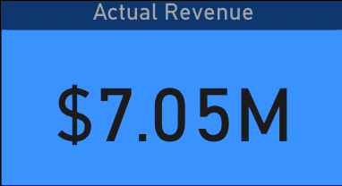
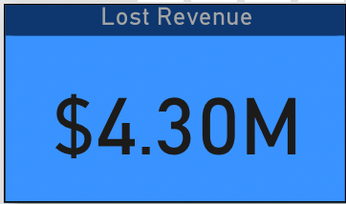
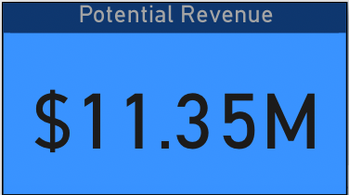
PROBLEM STATEMENT
Predict the cancellation of hotel bookings to:
Improve Revenue Management
Prevent Risk of Overbooking
Optimize Resource Allocation

Slide 3
DataSEt
Data & Source – Hotel Reservation Data from Kaggle - Link
Data Period - July 2017- December 2018
Meta Data
Particulars | Variables
Customer Demographics | No. of adults No. of children
Customer Preferences | No. of Special Requests Meal plan Parking space
Customer's Booking Information | Room Type Lead Time (between booking and arrival) Arrival date and time Market segment Average price per room
Customer's Previous History | No. of previous cancellations No. of previous bookings Repeated Guest

Slide 4
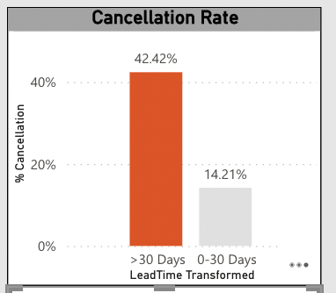
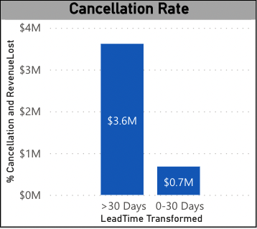
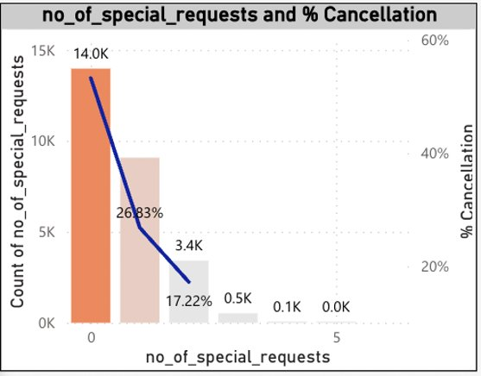
Exploratory DAta analyses

Slide 5
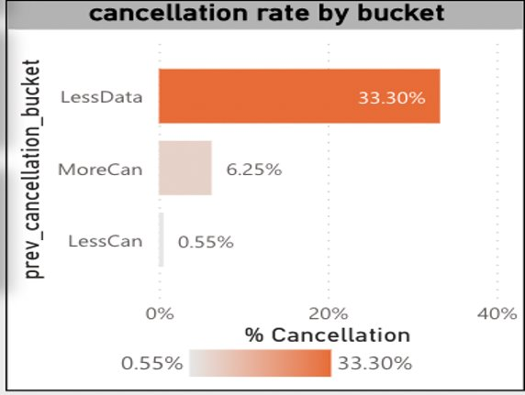
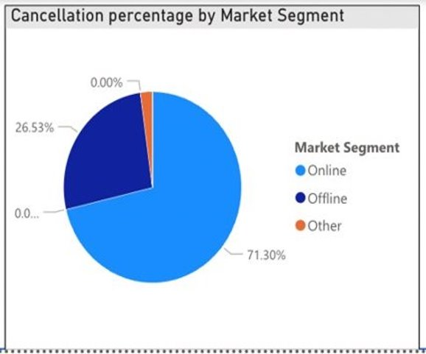
Exploratory DAta analyses

Slide 6
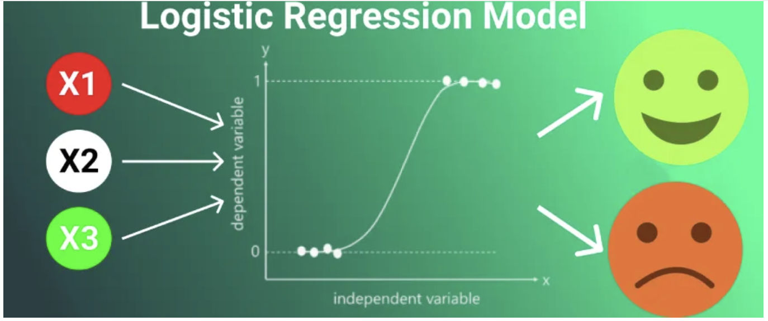
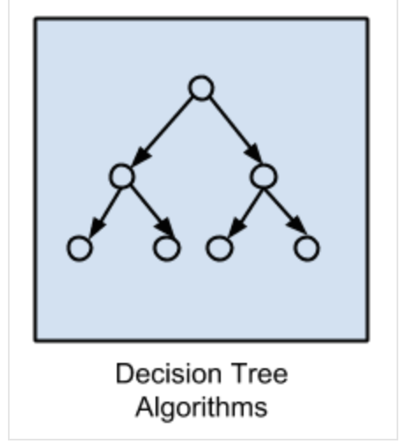
Analyses
WHY LOGISTIC REGRESSION ?
Binary Outcome - To predict Cancellation Status i.e. Cancelled (1) or Not-cancelled (0)
Logistic Regression or Tree based models are suitable for Classification
Probabilistic Interpretation - Predicting probabilities in scenarios where understanding the likelihood of an event (cancellation) is crucial
Interpretability – Using odds ratio, multiplicative change in odds for a one-unit change in the predictor variable, assuming all other variables are constant can be interpreted
Robustness to Outliers
Notes:
ChatGPT - For Hotel cancellation analysis we chose logistic regression model. Please provide General information about the model/analytics .
Logistic regression is a statistical method used for analyzing a dataset in which there are one or more independent variables that can be used to predict the outcome of a categorical dependent variable. In the context of hotel cancellation analysis, logistic regression can be employed to predict the probability of hotel guests canceling their reservations based on various features or factors.
Here's some general information about logistic regression and its application in analytics:
Binary Outcome:
Logistic regression is particularly useful when the dependent variable is binary, meaning it has only two possible outcomes. In the case of hotel cancellation analysis, the outcome variable might be binary, indicating whether a booking was canceled (1) or not (0).
Log-Odds Transformation:
Logistic regression models the relationship between the independent variables and the log-odds of the dependent variable. The logistic function (sigmoid function) is used to transform these log-odds into probabilities. This function ensures that the predicted probabilities lie between 0 and 1.
Interpretability:
The coefficients of the logistic regression model represent the change in the log-odds of the dependent variable for a one-unit change in the corresponding independent variable. These coefficients can be interpreted to understand the impact of each predictor on the likelihood of the event (cancellation in this case).
Assumptions:
Logistic regression assumes that the relationship between the independent variables and the log-odds of the dependent variable is linear. It also assumes that there is no multicollinearity among the independent variables.
Model Evaluation:
Model performance can be evaluated using various metrics such as accuracy, precision, recall, F1 score, and area under the Receiver Operating Characteristic (ROC) curve. These metrics help assess how well the model predicts cancellations and whether it is suitable for practical use.
Feature Selection:
Logistic regression allows for the inclusion of multiple independent variables, but it's important to select relevant features. Feature selection methods can help identify the most influential predictors and improve model performance.
Implementation in Analytics:
Logistic regression can be implemented using various statistical software or programming languages such as Python (using libraries like scikit-learn or StatsModels), R, SAS, and others. These tools provide functions for model training, evaluation, and interpretation.
Business Insights:
Analyzing the logistic regression results can provide valuable insights for hotel management. For example, which factors contribute significantly to cancellations? Understanding these factors can inform strategic decisions to minimize cancellations and optimize hotel operations.

Slide 7
Result & Insights
Model Summary
Variable | Odds Ratio | p-value** | Interpretation/Action
Car parking space | 0.2052 | 0.0000 | One unit increase will decrease the odds of cancellation by 0.2 times (20%). Having a parking space will provide more convenience and security to the customers, and therefore will be beneficial for reducing cancellations
No of special requests | 0.2266 | 0.00000 | One unit increase will decrease the odds of cancellation by 0.22 times (22%). By providing special services to the customers, will likely reduce the cancellation as customer relationship ranks highest in hospitality sector
Lead time | 1.0159 | 0.0000 | One unit increase will increase the odds of cancellation by 1.01 times (1%). This implies as the lead time (between booking and arrival) increases, the chances of cancellation tend to increase
Market segment Online | 6.121 | 0.00000 | One unit increase will increase the odds of cancellation by 6.121 times . Customers booking online are more likely to cancel as compared to offline customers due to more flexibility and easy comparibility between options available
Avg price per room | 1.0194 | 0.0000 | One unit increase will increase the odds of cancellation by 1.01 times (1%). Price changes have impact on the cancellations, thereby if any competitor is offering more better, customers tend to cancel the booking
More Previous cancellations | 12.3591 | 0.0332 | One unit increase will increase the odds of cancellation by 12.3591 times . Customers with history of previous cancellations, are more likely to cancel bookings as compared to less cancellations group

Slide 8
Strategies
Dynamic Cancellation Charges System
Develop system for calculating flexible cancellation charges
Identified main drivers like no.of previous cancellations, lead time, arrival day, market segment, etc
Clearly communicate the policies to the customers
Scenario No. | Previous cancellation | Lead Time | Arrival Day | Cancellation charge
1 | 3 | 7 days | Friday | 1x
2 | 4 | 15 days | Friday | 1.5x
3 | 0 | 30 days | Wed | 1x
4 | 2 | 30 days | Wed | 2x

Slide 9
Strategies
Personalised Customer Experience
Create customised offers or packages
Exclusive perks for loyal customers
Advertising & Sales Promotions
Boost offline market segment by advertising at gas stations, grocery stores, etc
Loyalty Programs
Incentives for direct bookings
Establish a tiered loyalty program
Implement customer relationship system to track preferences
Showcase testimonials of positive guest experience
Use targeted online advertising platforms like Google

Slide 10
Conclusion
Predict cancellations using logisitic regression to identify the features contributing to the cancellations
Methods like SHaP, LIME and other models could be used for increasing the interpretability of the machine learning models
The following strategies are recommended
  Dynamic cancellation charges Mechanism
  Customized services to the customers
  Loyalty programs
  Advertising and sales promotions

Slide 11
APPENDIX
"Take a data-driven detour into our Power BI dashboard! Click the link below to explore the world of hotel reservations, where we've unveiled the intriguing patterns behind cancellations. Your analytical adventure awaits!"
POWER BI LINK

